Slide 1
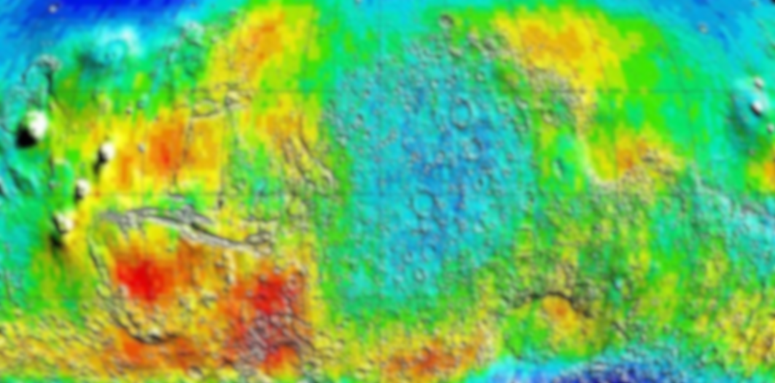
Activity 2: Spectral imaging
Physics 301
2nd Semester, AY 2021-2022
Submitted by: Mark Jeremy G. Narag
Student Number: 2014-64423
Program: PhD Physics

Slide 2
Spectral imaging
Objectives:
Render image color given spectral information
Find hyperspectral image databases
Demonstrate how color changes under varying illumination

Slide 3
Spectral imaging
Brief introduction on spectral imaging
Step-by-step Matlab code for patch rendering
Rendered Macbeth chart under different illuminance
CIE illuminant A and D65
CIE Fluorescent lamps
Rendered scene

Slide 4
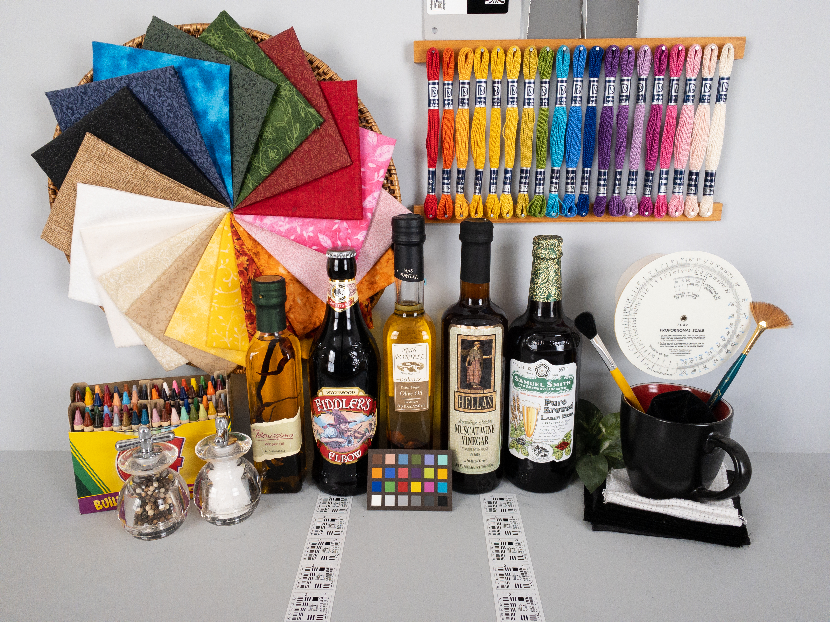
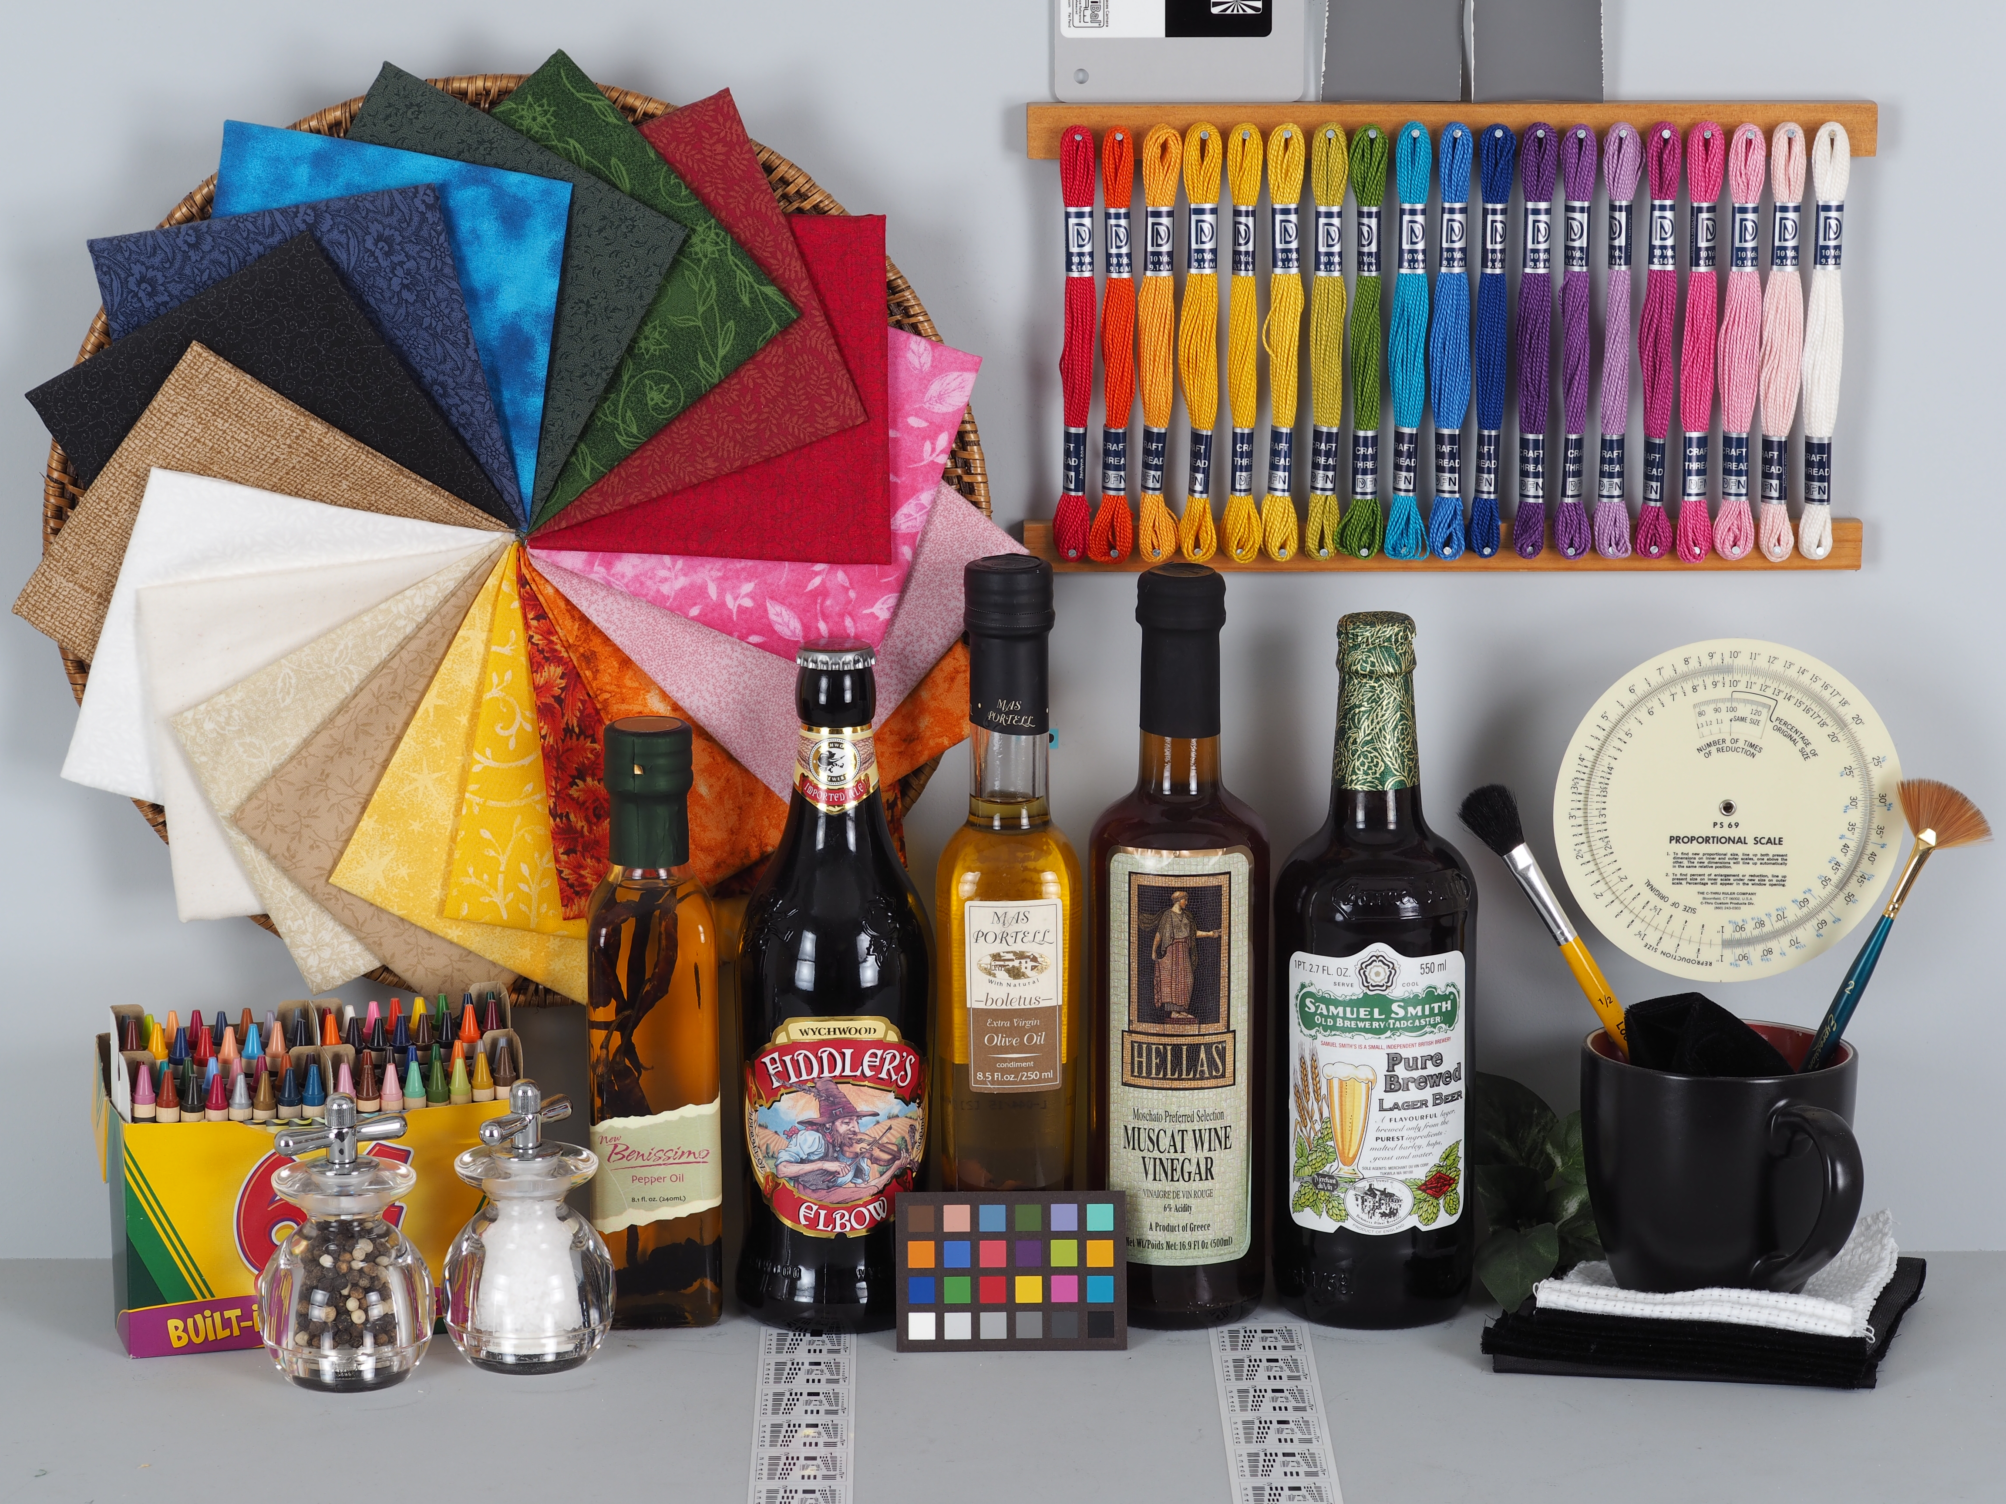
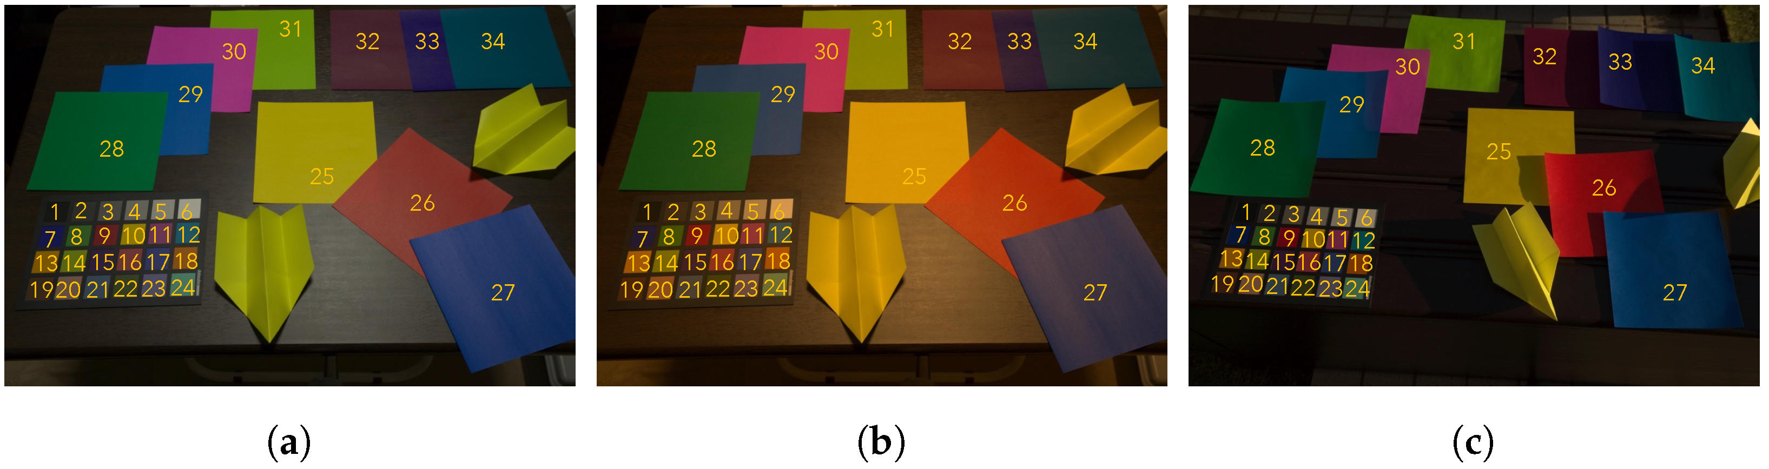
I. Brief Introduction on spectral imaging
RGB color is an unstable feature of an image since color varies depending on the light source and camera used in capturing the image. A simple example can be seen in the figure below where the color of the object varies depending on the camera used or the light source.
Photo taken by Iphone 11 is brighter.
Images retrieved from: Imaging Resource Comparometer https://www.imaging-resource.com/IMCOMP/COMPS01.HTM
You may check this site for more examples of pictures taken by different cameras and models! From Canon to Nikon, Fujifilm, and Sony, Panasonic, etc.
Taken by Iphone 11
Taken by Olympus Air
Images taken under three different light sources. (a) Ground truth image, (b) image taken under warm white light, and (c ) image taken under daylight. [1]
[1] Akazawa T, Kinoshita Y, Shiota S, Kiya H. Three-Color Balancing for Color Constancy Correction. Journal of Imaging. 2021; 7(10):207. https://doi.org/10.3390/jimaging7100207

Slide 5
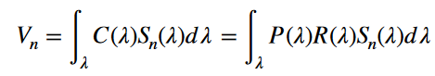
II. Step-by-step Matlab code for patch rendering
Our goal is to get the analog signal for the nth color channel, V_{n}, where n = red, green, blue channel.
P(λ) is the spectral power distribution of the light source, R(λ) is the reflectance of the object, S_{n}(λ) is the spectral sensitivity of the camera.
The available data for P(λ), R(λ), and S_{n}(λ) are usually given in varying intervals, d(λ). Based on Equation 1, we should make our data for P(λ), R(λ), and S_{n}(λ) have the same interval, d(λ), in this case, let’s make it d(λ) = 5nm.
(1)

Slide 6
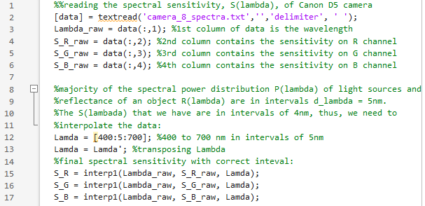
II. Step-by-step Matlab code for patch rendering
Since data are in different intervals, we need to interpolate first:

Slide 7
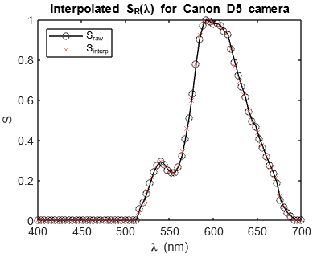
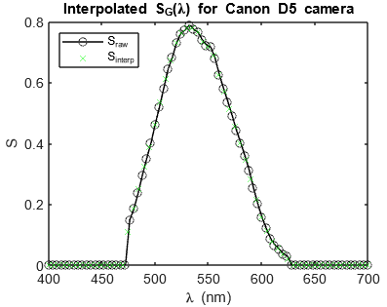
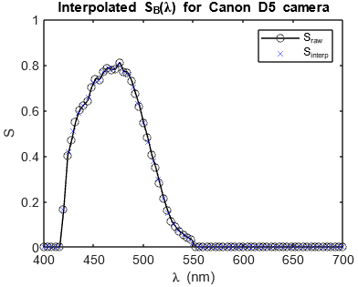
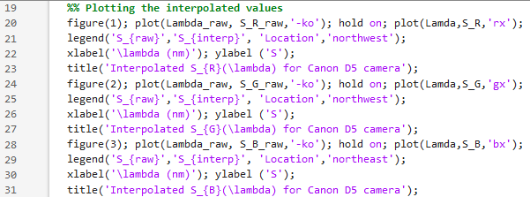
II. Step-by-step Matlab code for patch rendering
Checking the interpolated data:

Slide 8
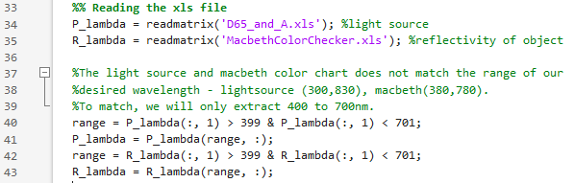
II. Step-by-step Matlab code for patch rendering
Next, let’s read P(λ), R(λ).
As an example, let’s choose the CIE Illuminant A and D65 for P(λ) and reflectance of Macbeth chart for R(λ)
In line 40-43, we just cut the column from 400 to 700nm to match our S_{n}(λ)

Slide 9
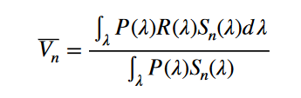
II. Step-by-step Matlab code for patch rendering
Going back to equation 1, we still need to normalize it (white object will look white). Since white object has reflectance equal to 1 across all wavelengths, equation 1 will transform into:
This is also called white balancing. V_{n} will now be our final analog signal for an object/patch.
(1)

Slide 10
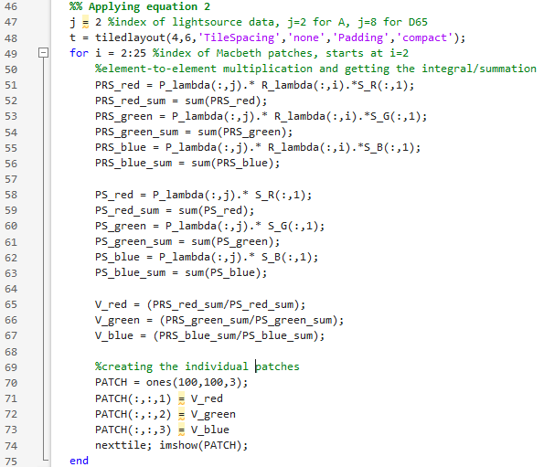
II. Step-by-step Matlab code for patch rendering
Applying equation 2:
Instead of rendering just a single patch on the Macbeth chart, let’s automate it and render everything!!
Remember that V_n has a value between 0 and 1

Slide 11
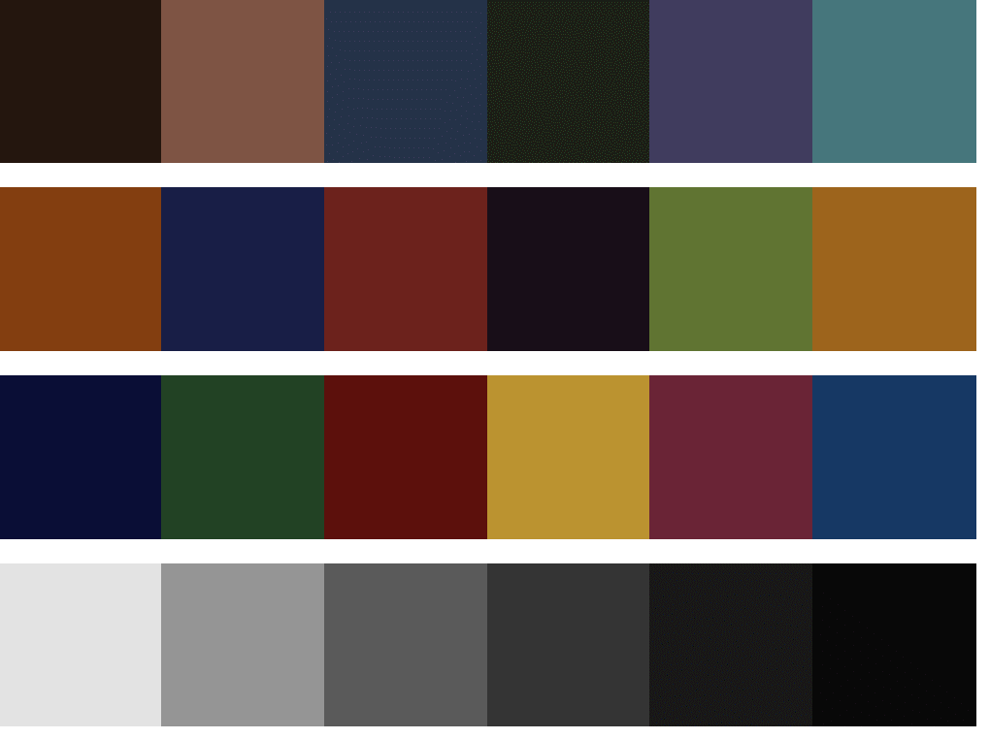
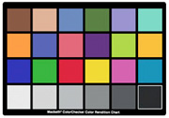
III. Rendered Macbeth Chart under different illuminance
Figure 1: Rendered Macbeth chart under CIE Illuminant A
1 2 3 4 5 6
7 8 9 10 11 12
13 14 15 16 17 18
19 20 21 22 23 24
Macbeth color checker from: http://www.rit-mcsl.org/UsefulData/MacbethColorChecker.xls

Slide 12
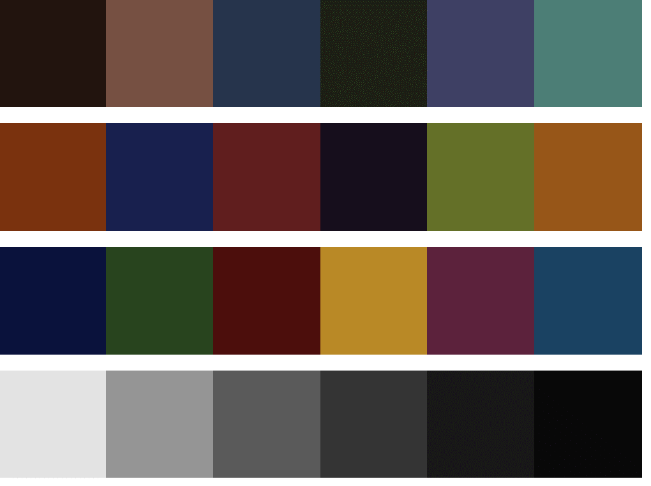
III. Rendered Macbeth Chart under different illuminance
Figure 2: Rendered Macbeth chart under CIE Illuminant D65
1 2 3 4 5 6
7 8 9 10 11 12
13 14 15 16 17 18
19 20 21 22 23 24
Macbeth color checker from: http://www.rit-mcsl.org/UsefulData/MacbethColorChecker.xls

Slide 13




Figure 4:Subtle difference of A (back) and D65 (front)
III. Rendered Macbeth Chart under different illuminance
On patch 7
On patch 13
On patch 9
On patch 18

Slide 14
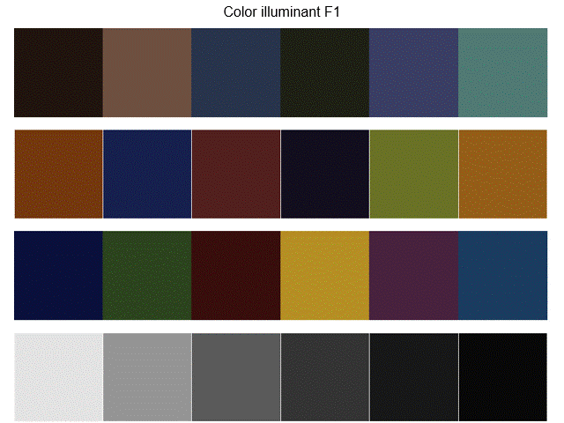
III. Rendered Macbeth Chart under different illuminance
Figure 3: Rendered Macbeth chart under different Fluorescent lamps (play in gif)
From the rendered Macbeth charts in Figures 1-4, it is obvious that the changes in color under different illuminances is perceptible.
Now, let’s try to render a scene under different illuminances AND camera!

Slide 15
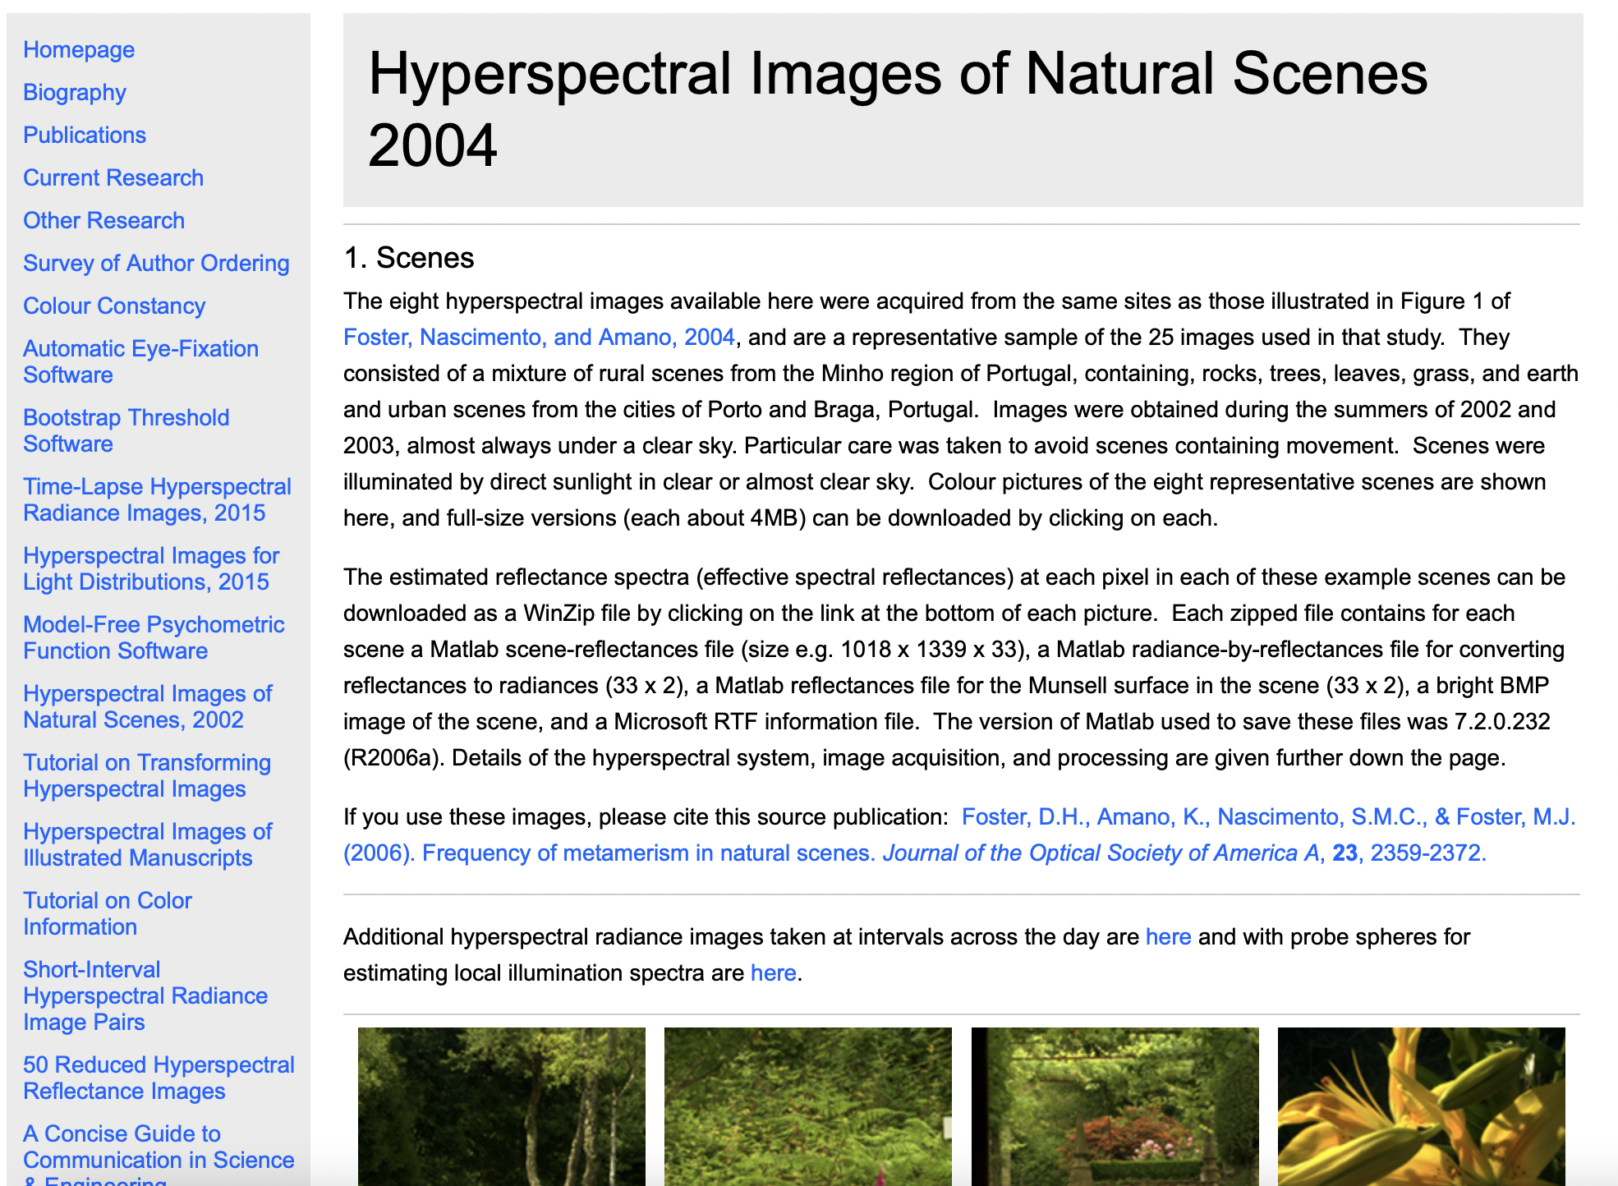
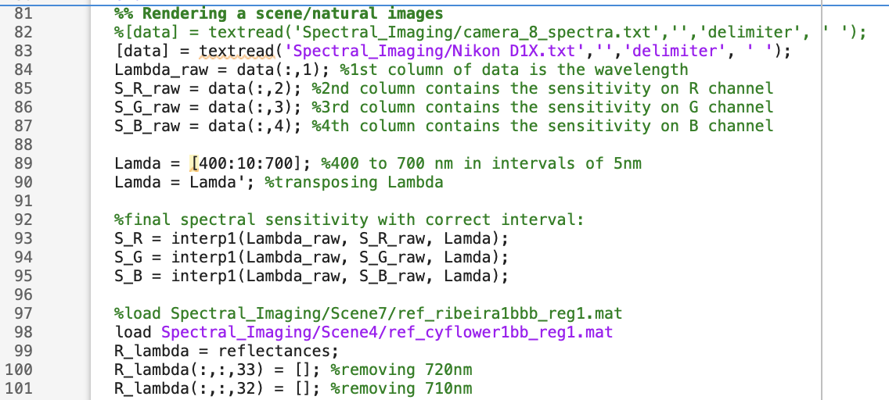
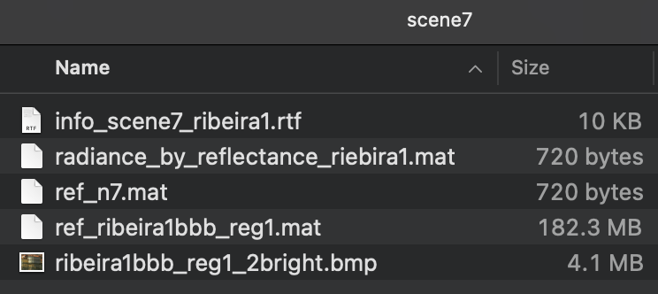
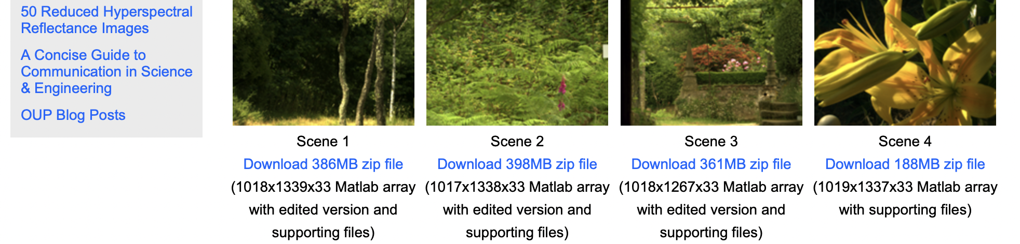
IV. Rendered scene Matlab code
But first, let’s visit our Matlab code and how to modify it. I downloaded the natural scenes from Hyperspectral Images of Natural Scenes 2004 [2] (special mention to Jonel who gave me the link who told me he got it from Christian)
When we download the scene, we will get 5 files in the folder. The one with the biggest size contains the reflectance of the scene, pixel-per-pixel in range 400 to 720nm in intervals of 10nm. See line 98-101.
[2] https://personalpages.manchester.ac.uk/staff/david.foster/Hyperspectral_images_of_natural_scenes_04.html?fbclid=IwAR3WbQSIq4KgB1A1d810yBQz9l6zW9czwS0ppx28w5rKXBoW5iLbNeKAxkc

Slide 16
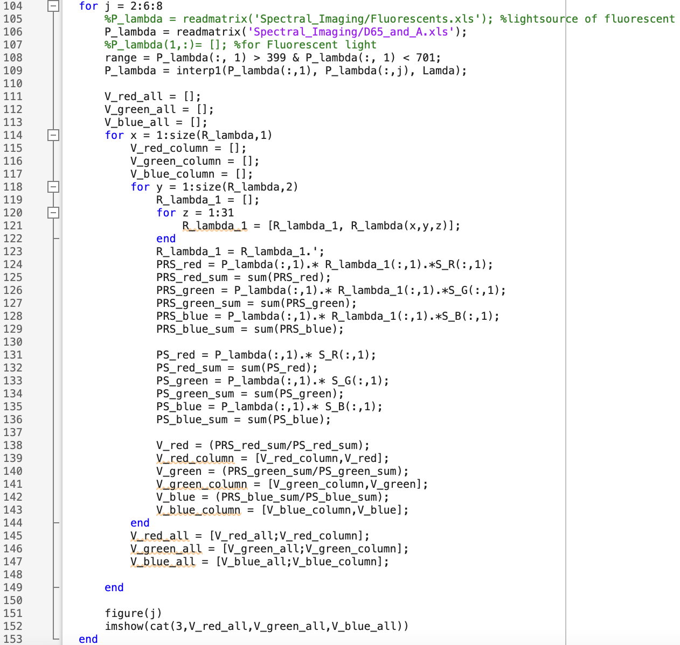
IV. Rendered scene Matlab code
⨯
The size of the reflectance data is M⨯N⨯33, where M and N are the dimensions and 33 is the corresponding reflectance per wavelength. We removed 710 nm and 720 nm previously.
The code is similar from the one we have in rendering Macbeth charts. We just added several for loops (x,y,z) to iterate the process of computing the new RGB values for each pixel of the scene (lines 114, 118, 120).
PS I’m a python apologist so I’m used to applying for loops. I am quite aware that I can still shorten my code, but I like the step-by-step view of for loops. Example, I realize that I don’t need the for loop in z. I can just stop at x and y and use R_lambda_1(x, y, :). But it’s just a matter of the language you’re used to. I’ll adapt soon.

Slide 17
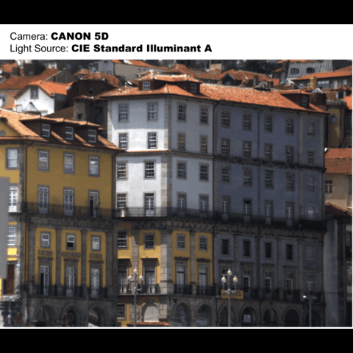
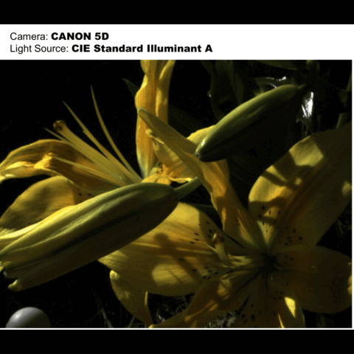
IV. Rendered scene under different illuminances
Figure 5. Rendered two scenes under different illuminances using Canon 5D (play in gif)
Here is another proof that different light sources affects the color of an image - and that color is an unstable feature of an image.

Slide 18
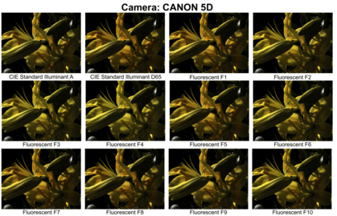
IV. Rendered scene under different illuminances and camera sensitivities
Figure 6. Rendered scenes under different illuminances and different cameras (play in gif)
We can see here that in all illuminances, NIKON D1X produces a warmer tone than CANON 5D. This is a proof again that camera sensitivities affect the color of an image.

Slide 19

CRITERIA | QUALIFICATIONS | SCORE
Technical correctness | Met all objectives. Results are complete. Results are verifiably correct. Understood the lesson. | 30
Quality of presentation. | All text and images are of good quality. A picture or diagram of the setup is shown (if the activity has one). Code has sufficient comments and guides. All plots are properly labeled and are visually understandable. The report is clear. | 30
Reflection | Explained the validity of results. Discussed what went right or wrong in the activity. Justified the self score. Acknowledged sources (e.g. persons consulted, references, etc.) | 30
Ownership | Applied the technique on other data Discovered limitations in the technique (Not applicable, it’s a straightforward matrix multiplication) Introduced improvements to the technique (N/A) I went beyond the objective (Demonstrate how color changes under varying camera sensitivities. ) | 10
100

